Slide 1
Integrating case reports into BMJ Best Practice
January 2022
Tony Hilker – Commercial Director APAC
thilker@bmj.com

Slide 2
Background
BMJ Best Practice is a generalist point of care tool that mainly provides information on common diseases and presentations. This is what our users tell us they need to support them at the point of care
Users have told us they have limited access to reliable and peer reviewed information on rare diseases and uncommon presentations
Users have told us that these rare conditions and uncommon presentations are difficult to diagnose
Because of the nature of the use case, it's value to the user, when it is needed, is considerable.

Slide 3
What is a case report?
A case report provides a detailed report of the symptoms, signs, diagnosis, treatment, and follow-up of an individual patient. Case reports usually describe an unusual or novel occurrence, they are peer-reviewed and used in all medical disciplines. They provide healthcare professionals, researchers, and students clinically important information on common and rare conditions.
Case reports bring practice to life and provide healthcare professionals with fast access to information on rare diseases and uncommon conditions and presentations from a trusted source.
As humans we’re better at remembering something as a story - case reports offer a narrative that supports this.

Slide 4
Key messages
BMJ Best Practice has integrated a carefully curated selection of case reports which cover rare diseases and uncommon conditions and presentations
These case reports are only included in our licensed packages ‘Everywhere’ and ‘360’.
Currently, 5,000+ case reports are included. This collection is date limited to case reports published in the last 5 years
Case reports bring practice to life and provide healthcare professionals with fast access to information on rare diseases and uncommon conditions and presentations from a trusted source
Case reports are fully searchable via a new section on the BMJ Best Practice website.
Case reports are kept intentionally separate from the evidence-based information that forms the core of BMJ Best Practice. This ensures healthcare professionals' workflow is not interrupted or distracted with rare and uncommon cases until the time they need them
Case reports are not included on the app
As humans we’re better at remembering something as a story - case reports offer a narrative that supports this

Slide 5
The solution
To add case reports of rare diseases and uncommon presentations into BMJ Best Practice
What does this mean?
Integration of selected case reports into Best Practice 360 and Best Practice Everywhere licenses.
Supports clinicians and students with quick access to information and guidance on rare diseases and uncommon conditions and presentations within the tool they are already using
Integration of a selection of recent case reports
These case reports cover rare diseases and uncommon conditions and presentations.
There are approximately 5,000+ case reports included and this collection is date limited to the last 5 years.
On website only. Not on the app at this time.
What isn’t it?
It isn’t a way to publish case reports – for this you still need a licence to BMJ Case Reports
It is not a way to access of all BMJ Case Reports - only a relevant subset of case reports included in Best Practice based on topics and date.
Therefore we/you should not refer to this as BMJ Case Reports integration

Slide 6
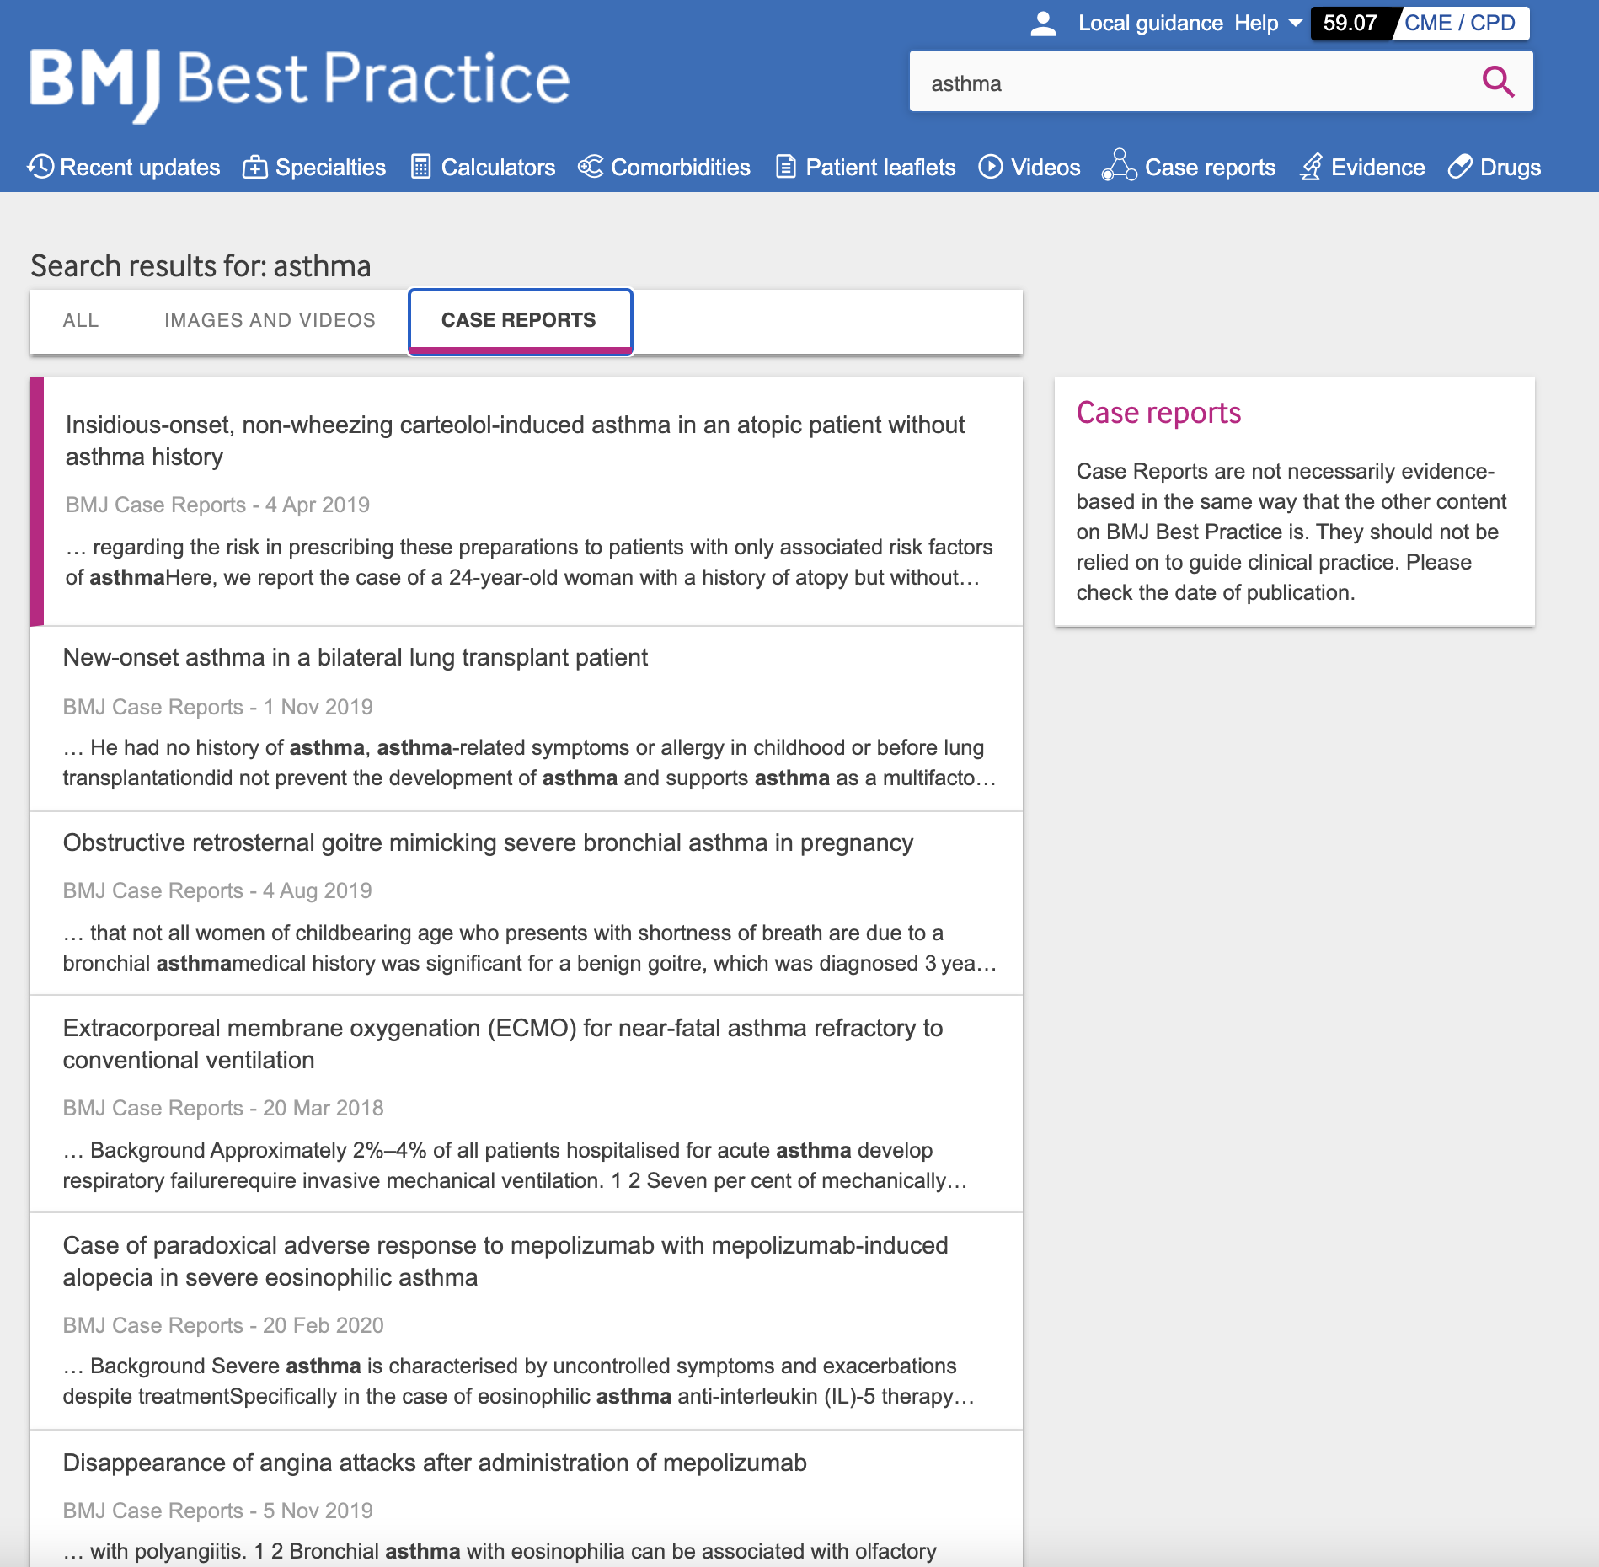
The solution
Finding case reports on BMJ Best Practice
A user can search for a generic word such as “Asthma” from the main search bar, and see relevant results of case reports, by going to the ‘Case reports’ tab on the search results page
Please note that case reports articles are not included in the autosuggest

Slide 7
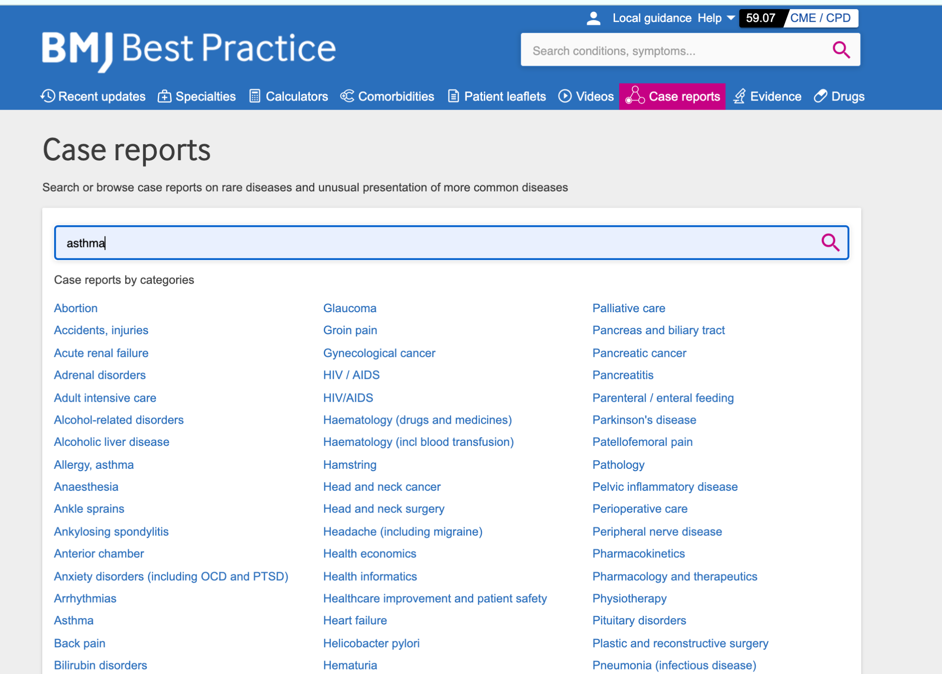
The solution
Case reports landing page
Where an institution has a BP Everywhere or 360 license, case reports will appear on the main navigation
By clicking on the navigation item, the user can browse case reports by specialty, as well as perform a search that will take them directly to the search results page of case reports

Slide 8
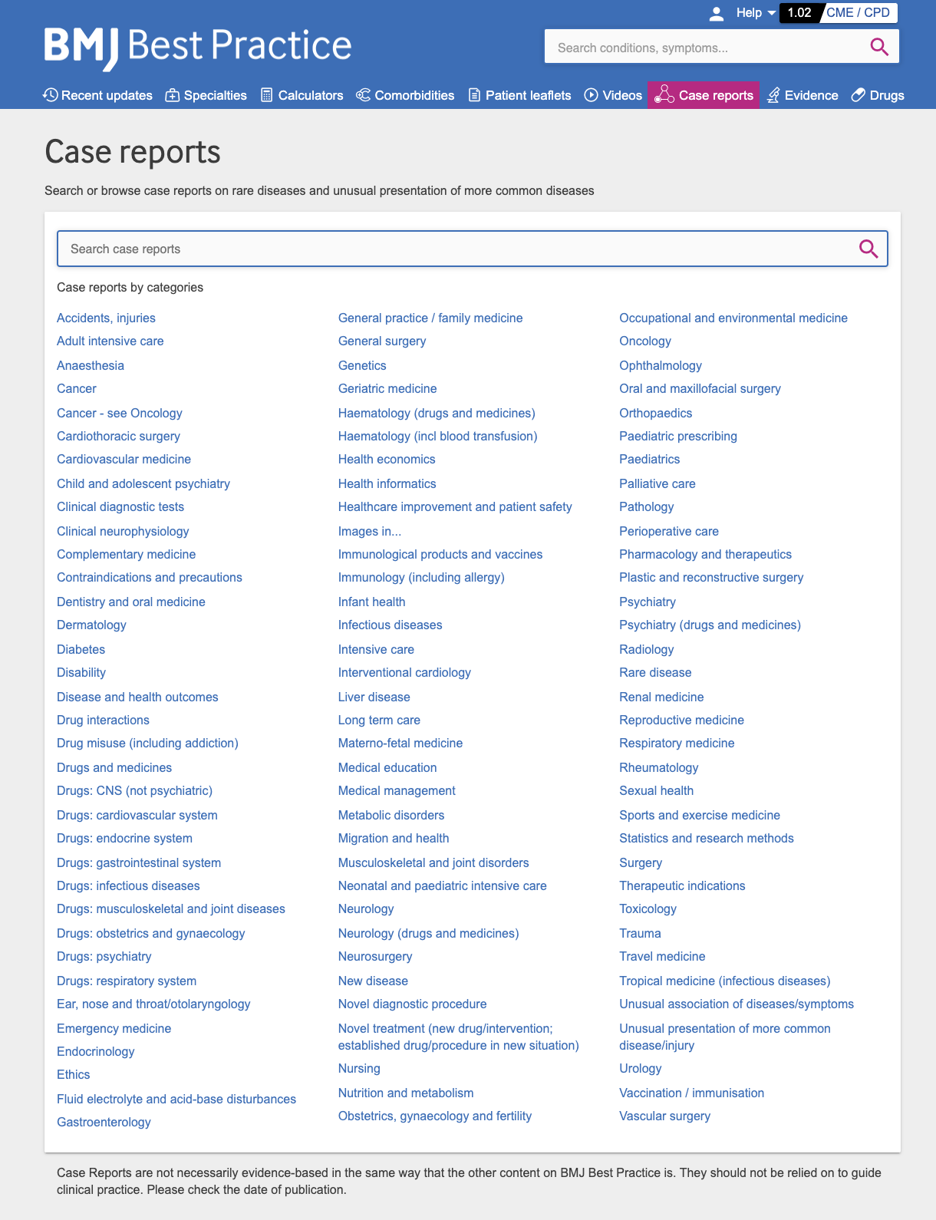
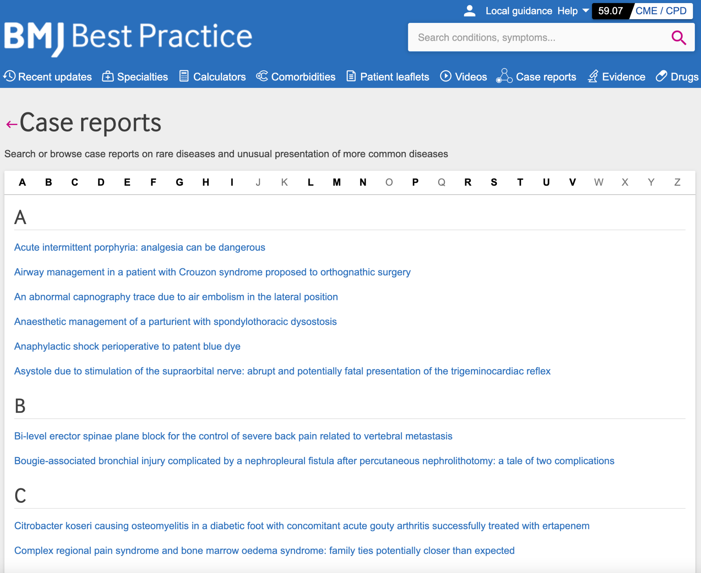
The solution
Case reports browse by specialty
On the case reports landing page, user can click on a specialty to then browse all case report articles related to that specialty

Slide 9
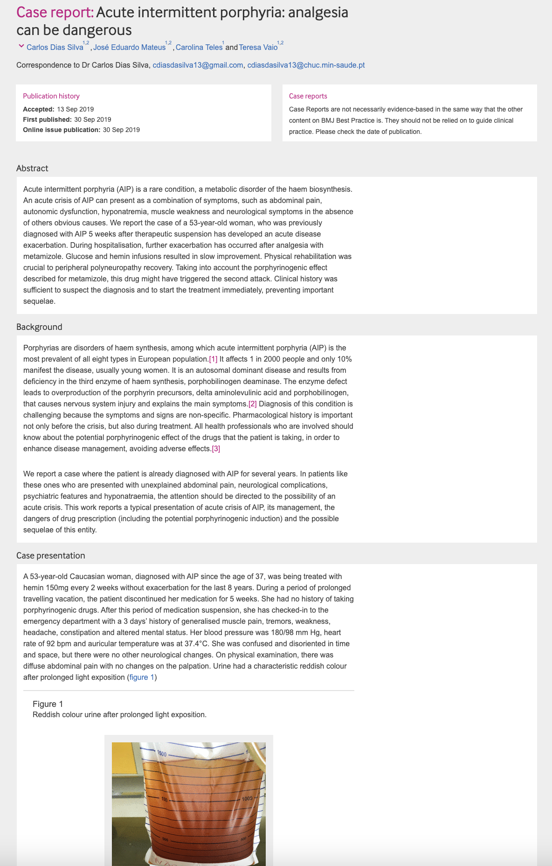
The solution
Reading a case report article
All case report articles have the following format:
English only
Case report title
Case report details; author, publication history
Content disclaimer
Abstract
Graphics – photos, charts, imaging etc
Background
Case presentation
Investigations
Differential diagnosis
Outcome and follow-up
Discussion
Learning points
References
Footnotes

Slide 10
FAQs

Slide 11
I’m an existing BMJ Case Reports customer - why should I continue to subscribe to both resources?
Approximately 5,000 case reports from the last five years will be made available in BMJ Best Practice to support healthcare professionals with quick access to information and guidance on rare diseases and uncommon conditions and presentations.
Case reports are fully searchable via a new section on the site and kept intentionally separate from the evidence-based information that forms the core of BMJ Best Practice. This ensures healthcare professionals' workflow is not interrupted or distracted with rare and uncommon cases until the time they need them.
This is a subset from BMJ Case Reports which has in excess of 25,000 case reports going back to 2008. The selection within BMJ Best Practice therefore equates to ~12% of the entire case reports database.
Case reports on BMJ Best Practice will only ever cover the latest five years. Users of BMJ Best Practice will not be able to submit a case for publication; this can only be done via a subscription to BMJ Case Reports.
BMJ Best Practice users will not be able to access these case reports on the app.

Slide 12
What are case reports?
Are they evidence based? Or peer reviewed?
They are an educational resource offering healthcare professionals access to clinically important information on common and rare conditions. All articles are peer reviewed and copy edited before publication.
What are the benefit of these case reports to my practice and/or learning?
They highlight cases worthy of discussion, particularly around aspects of differential diagnosis, decision making, management, clinical guidelines and pathology. The advantage is that we learn from real and current cases.
How many of them are there?
Approximately 5,000 case reports from the last three years will be made available in BMJ Best Practice to support healthcare professionals with quick access to information and guidance on rare diseases and uncommon conditions and presentations.
How recent are they?
The case reports in BMJ Best Practice have been published since 2018. The collection of case reports will be kept updated to ensure they are no more than 5 years old.

